Slide 1
Product+Services Overview

Slide 2
COS Services? Memberships?
What’s all this now?

Slide 3
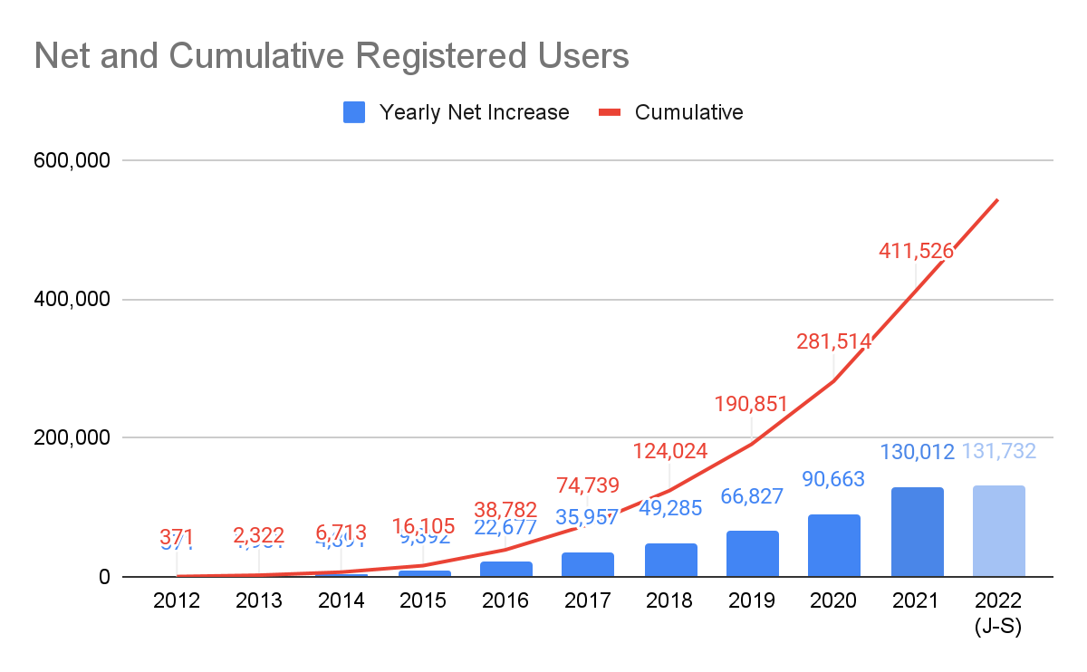
OSF Adoption

Slide 4

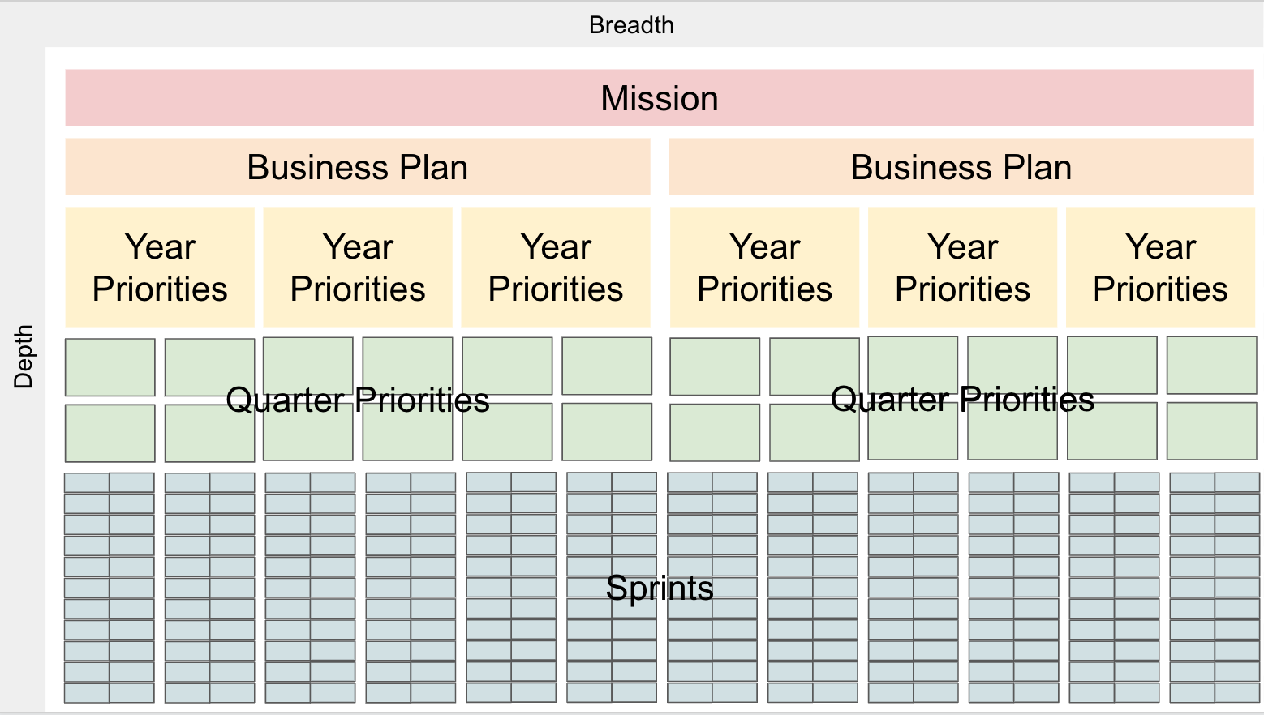
2019-2021 Business Plan
Imperative #3: “Seek new sources of support beyond our historical reliance on research grants and generous philanthropic foundations. This includes launching fee for service experiments with different customer groups, including university and research funders.” (2019-2021 business plan)
Mission VS. Market
Change
Mission
Market
Notes:
Beyond our mission we have the 3 year business plan that guides our activities
From the current biz plan there was an imperative that was identified for focus on in the 3 years: diversify sources of support through launching fee for service.
We seek a culture change, we’ve established why we have built specific interfaces and infrastructure to enable the change.
- Typical process would start at the market analysis before deciding what to build.
- We did a culture analysis and decided what needed to be built to support the change in research culture
Mission vs. Market
- The mission pushes for increasing open behaviors; into what may not be comfortable
- The market pushes for status quo, incremental changes, or highly innovative changes that only a few adopt
- Asking the market only for what the product must do will not lead to the culture change we seek, or it will be weak
Pause, invite discussion
- connection to the mission
- create new markets, rather than just serve existing ones

Slide 5
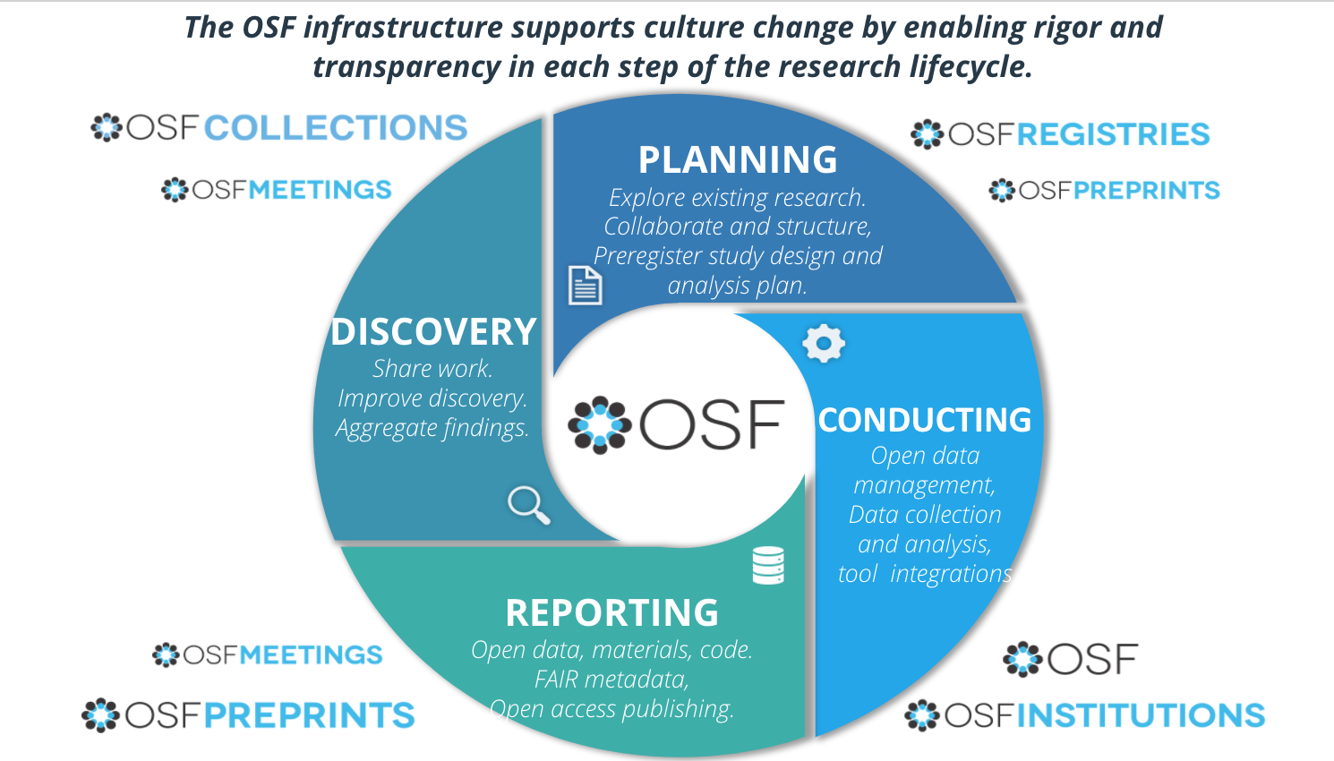
COS products
Notes:
OSF is designed to support the entire Research lifecycle as a collaborative management tool.
4 phases of research
1. Planning – explore existing research (preprints), collaborate and structure (OSF), preregister study design (Registries)
2. Conducting – active research with open data management, data collection, analysis (OSF) (OSF integrations), aggregation of research(OSFI)
3. Reporting – sharing of open data, materials, code, metadata (OSF)(Meetings), open access publishing (Preprints)
4. Discovery – sharing work, improving discovery of all aspects, transparency and aggregate findings (Collections)(Meetings)
We have interfaces that support each of those phases as stand alone, but that also connect to the one before and after, bringing research full circle.

Slide 6
What’s involved in running a service at COS?
User support, support documentation, user communication
Client community or organization onboarding, support for operating branded interfaces, and adoption and goal support
Internal translation of user needs, backlog of new features, improvements, bugs, grooming, requirements, user stories, prioritized project list, product vision,
User research, testing, NPS, data for data-driven decision making
KPIs, metrics, product evaluation
External stakeholder and customer market analysis, communication, product positioning
Communications, Community engagement, needs/gap analysis, open practice adoption support (resources)
Marketing, campaigns, content development, resource prioritization and management
Developing and delivering training/workshop material, adoption resources, and engagement programming

Slide 7
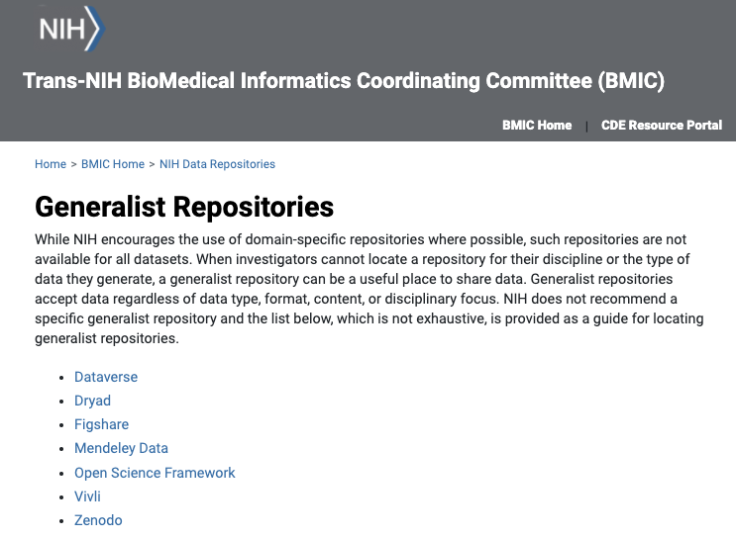
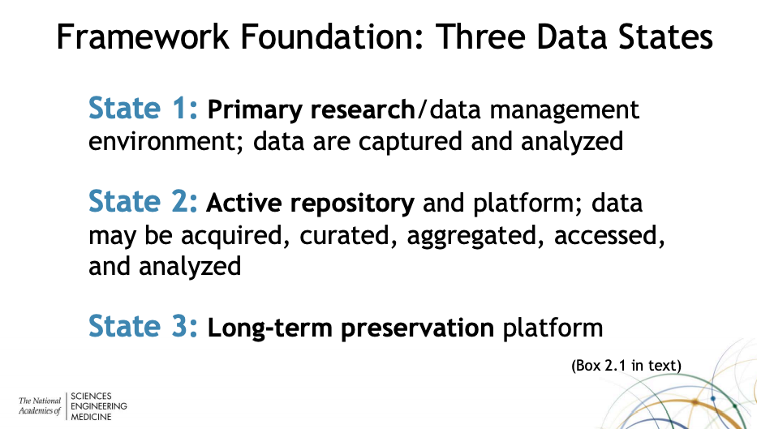
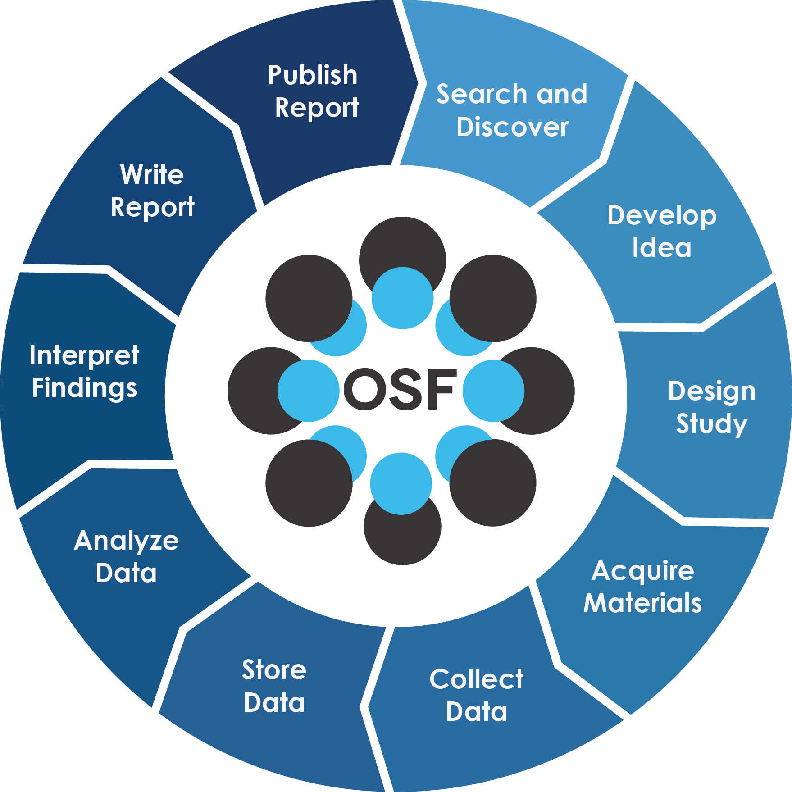
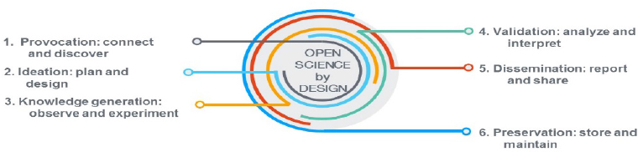
Landscape alignment
Research Lifecycle
NASEM’s vision for repositories
Open Science By Design
NIH Generalist Repository

Slide 8
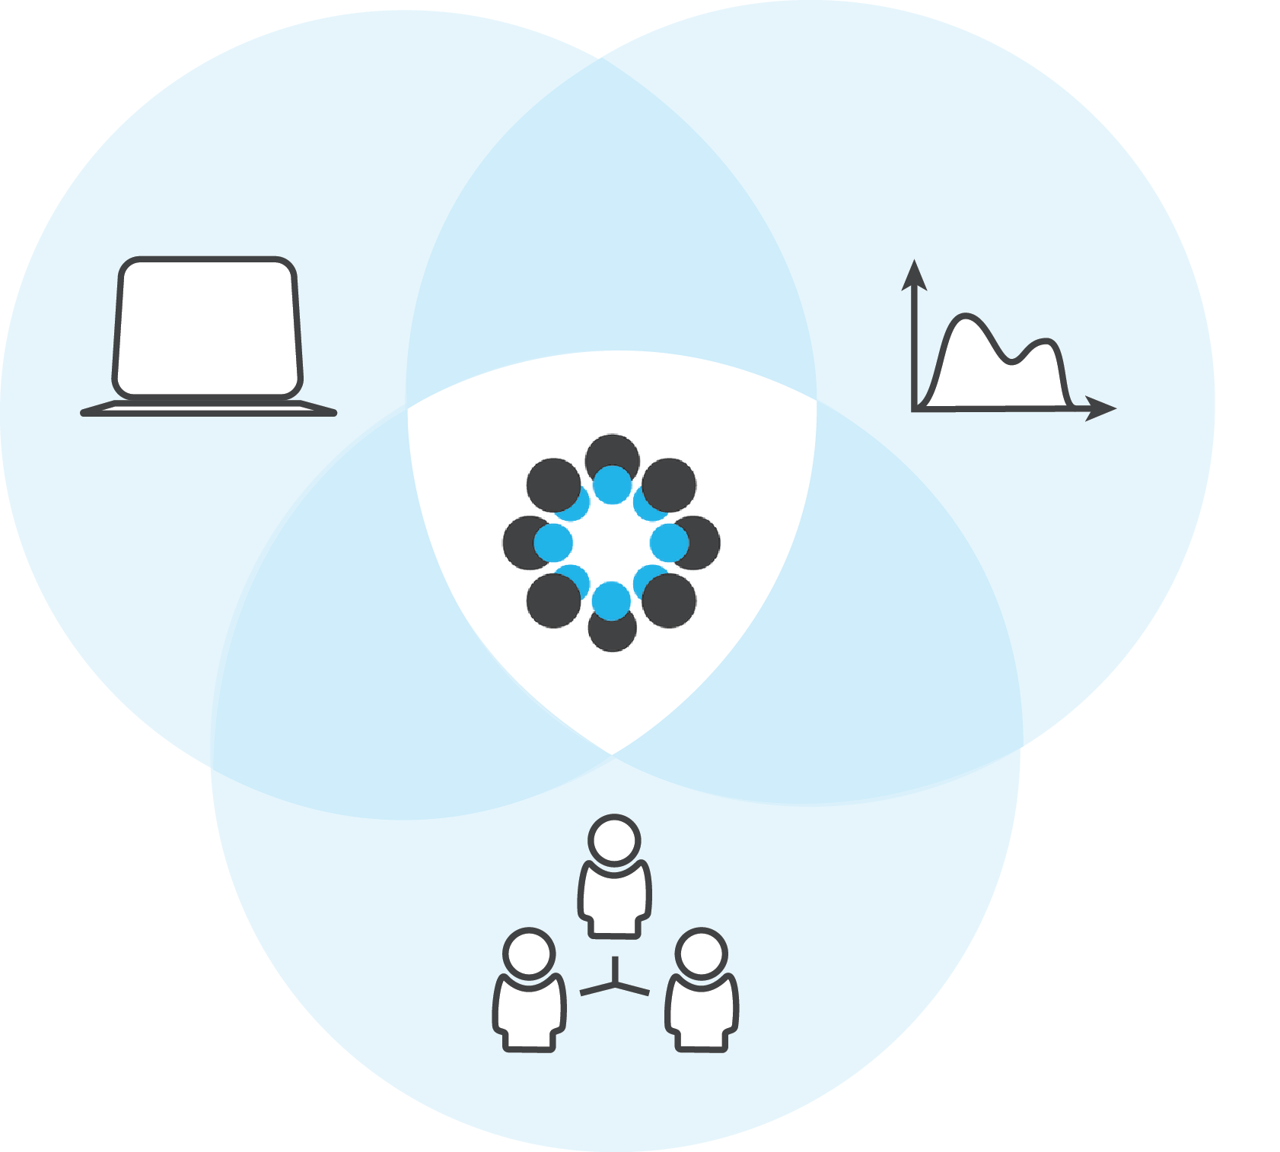
Partners in Open Science Infrastructure
How do we develop and maintain an ecosystem that can respond to many research community needs? Not alone!
We are constantly listening to and adapting for our 500,000 users and dozens of institutional partners. They in turn contributed 18 thousand preprints and 1 million projects that were downloaded over 23 million times in 2020 alone.
But key to the vision of OSF is to not create features that other services are already providing for researchers, so we seek integration at every opportunity!
Members and Supporters
Integrators and Interoperability
Research/Data Contributors and Consumers

Slide 9
Earned Revenue Model

Slide 10
Earned Revenue Model
The overarching principles guiding the earned revenue business models are:
Each product interface is designed for a specific initiation point for the supporting community to build adoption of new open behavior to create more normative behaviors. The ideal is for a community to add each of the interfaces to match their adoption of the open behaviors of preregistration (Registry), open sharing of data and materials (Collection), and open access reporting of findings (Preprint).
Value-based pricing will be used to set pricing for products and services based on the customer’s perceived value in meeting their goals, and is not heavily driven by the cost of the product or historical prices in the market. Volume-based pricing structures are in conflict with the success of the product adoption and the COS mission of culture change.
It’s simpler to set pricing tiers based on the levels of value that we can construct with the product or based on the customer’s ability to pay. We continue to implement value-based pricing that is aligned with our mission and goals, based on the key differentiators and market needs for each product.

Slide 11
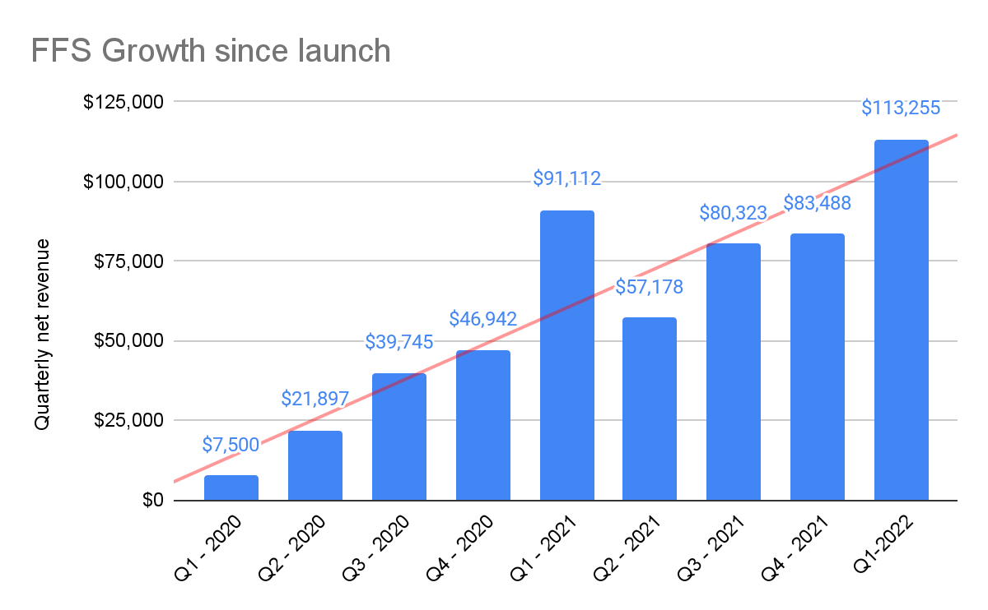
FFS Launch and Growth
Preprints: Q1-2020
Institutions: Q2-2020
Collections: Q3-2020
Registries: Q4-2020
$276,796 total revenue across all FFS products and services in 2021
$430k in all-time FFS revenue
Building renewing revenue base, $250k+

Slide 12
OSF Institutions

Slide 13
Institutional Strategy
Vision
OSF Institutions provides an interface to institutions that connects researchers with collaborators and resources to amplify sharing, reuse, and discoverability.
Partnership through Membership
Partnering with research institutions to enable open science practices
Supporting administrators with activity insights
Partnerships form with the institution’s library staff and research admins
Promote adoption of open science practices and build researcher capacity to implement (OSF, training)
Offering a spectrum of options to match institutional investment and capability

Slide 14
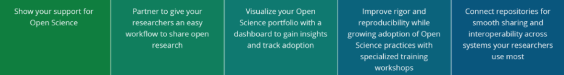
Membership Tiers
Monthly newsletter
 | SSO
 | Affiliate projects
 | Public aggregated discovery
 |  | Custom URL
 |  | Dashboard
 |  | Support priority
 |  | Discounted training
 |  |  | Quarterly strategy calls
 |  |  | 1 Training incl | 2 Training incl
 |  |  |  | Integration (up to 80 hours)
 |  |  |  | Discounted dev contracting

Slide 15
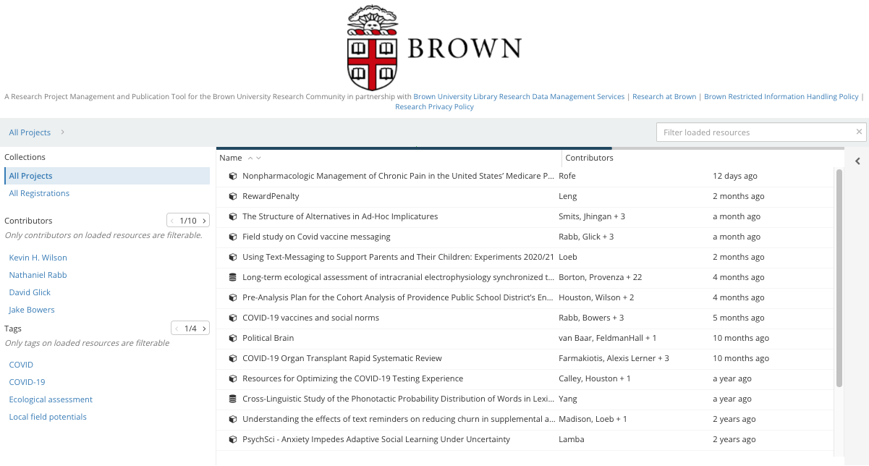
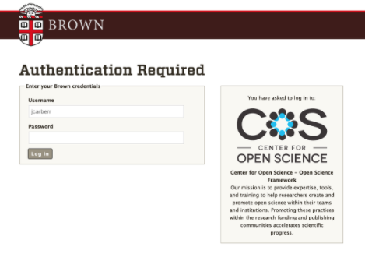
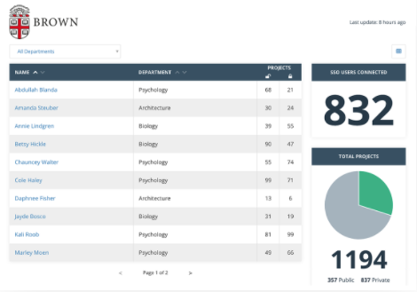
OSFI Interfaces
Branded Aggregated Discovery
SSO Authentication
Dashboard Insights

Slide 16
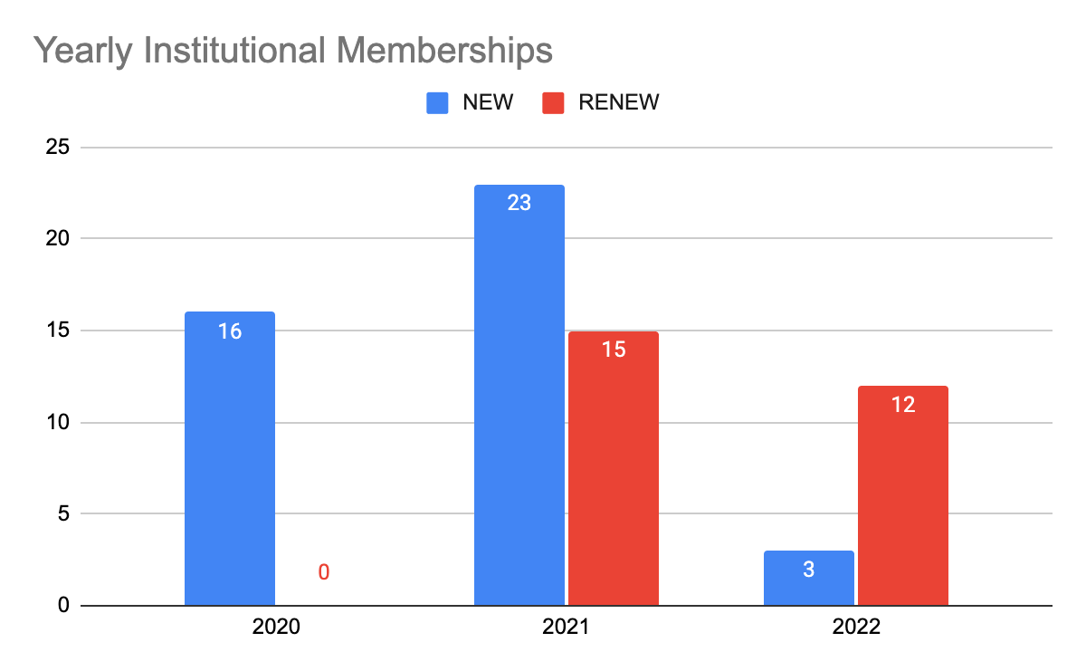
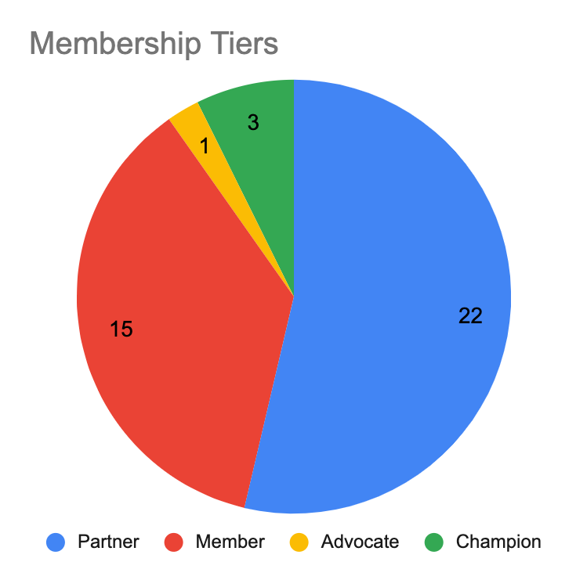
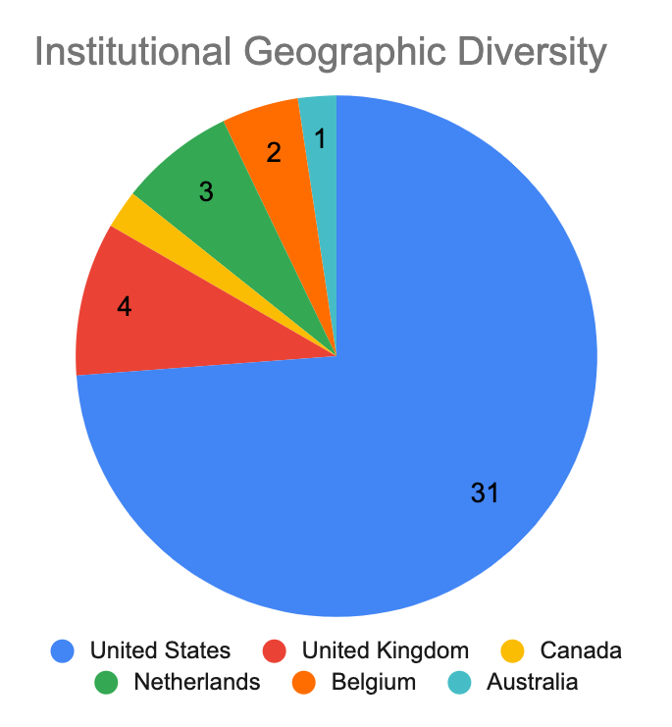
OSFI Members
45
OSFI Members
You can go to osf.io/institutions to see the full list of members
Notes:
OSFI launched in late Q2 of 2020
In first year converted 16 to members

Slide 17
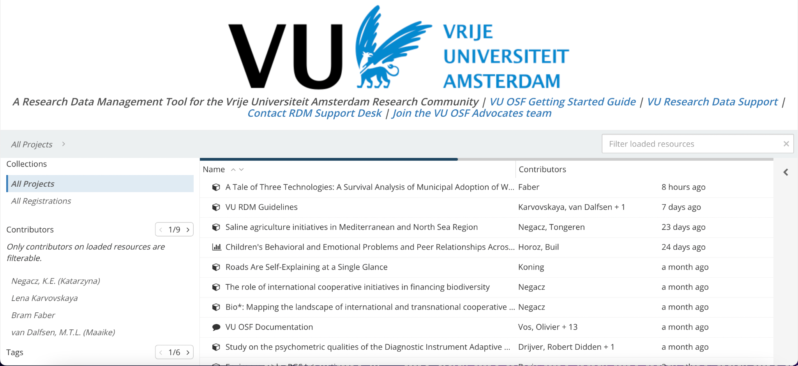
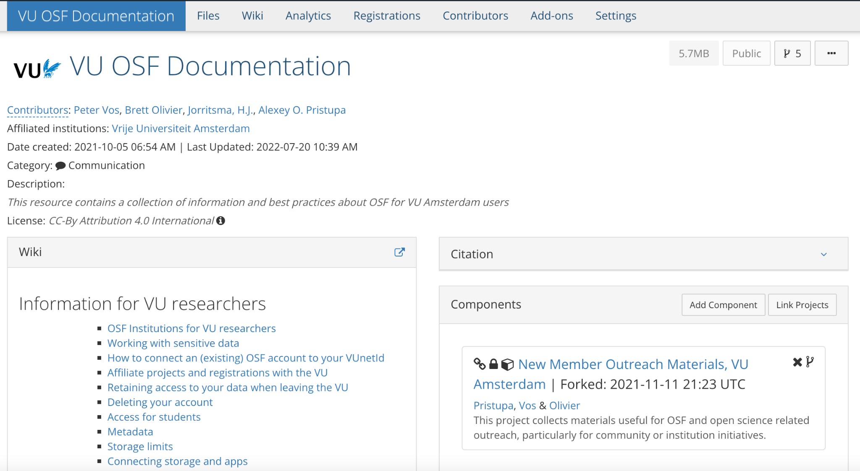
Partner$ that make it rain!

Slide 18
OSF Registries

Slide 19

OSF REGISTRIES
Improve Transparency and Rigor of Research
You set the standards. We’ve built the infrastructure.
Community operated registries are customized to meet the standards set by the stakeholders in your community. By launching a registry, you reflect the high expectations of transparency and rigor of your research area.

Slide 20

OSF REGISTRIES
A community-driven, open source service to improve research rigor and accelerate progress

Slide 21
OSF REGISTRIES
Benefits
Community operated registries are customized to meet the standards set by the stakeholders in your community. By launching a registry, you reflect the high expectations of transparency and rigor of your research area.

Slide 22
OSF REGISTRIES
Empowering communities to improve research rigor.

Slide 23
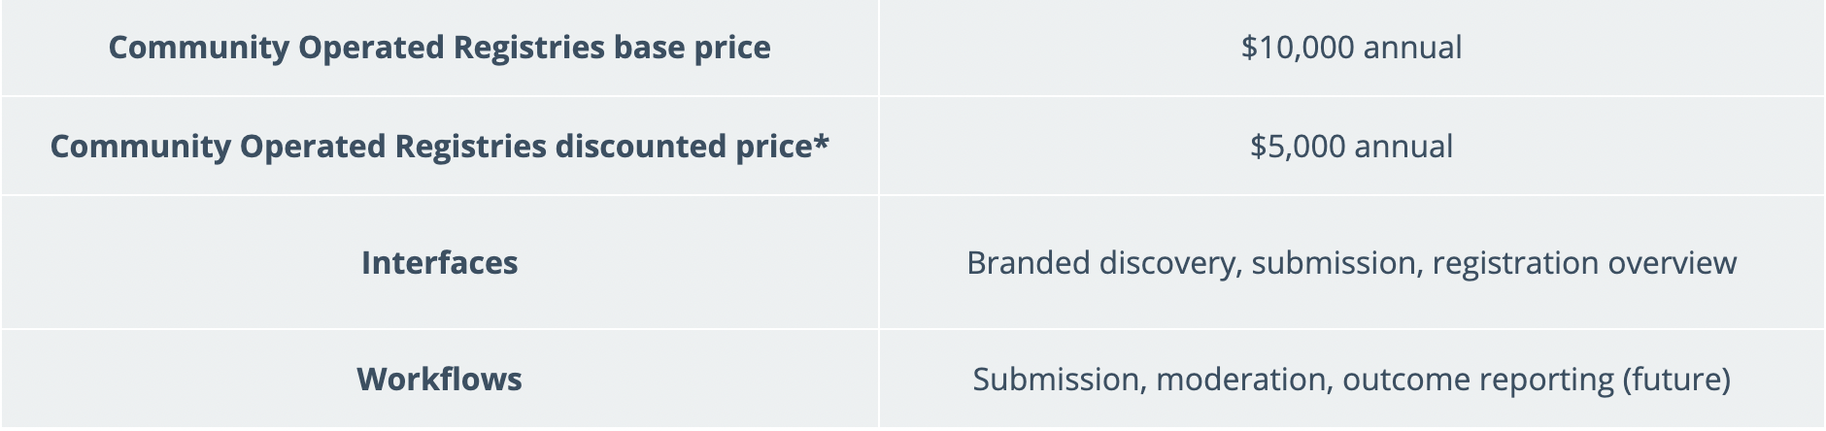
OSF REGISTRIES
Shared infrastructure, is sustainable infrastructure
COS believes in shared investment in open source, community infrastructure
*Discount criteria: Discounted prices are applied until registry moderation, logic forms functionality, and outcome reporting are made available. Base price will resume at the time of registry renewal, and for any new registries launched after that time. (Expected in 2023)

Slide 24
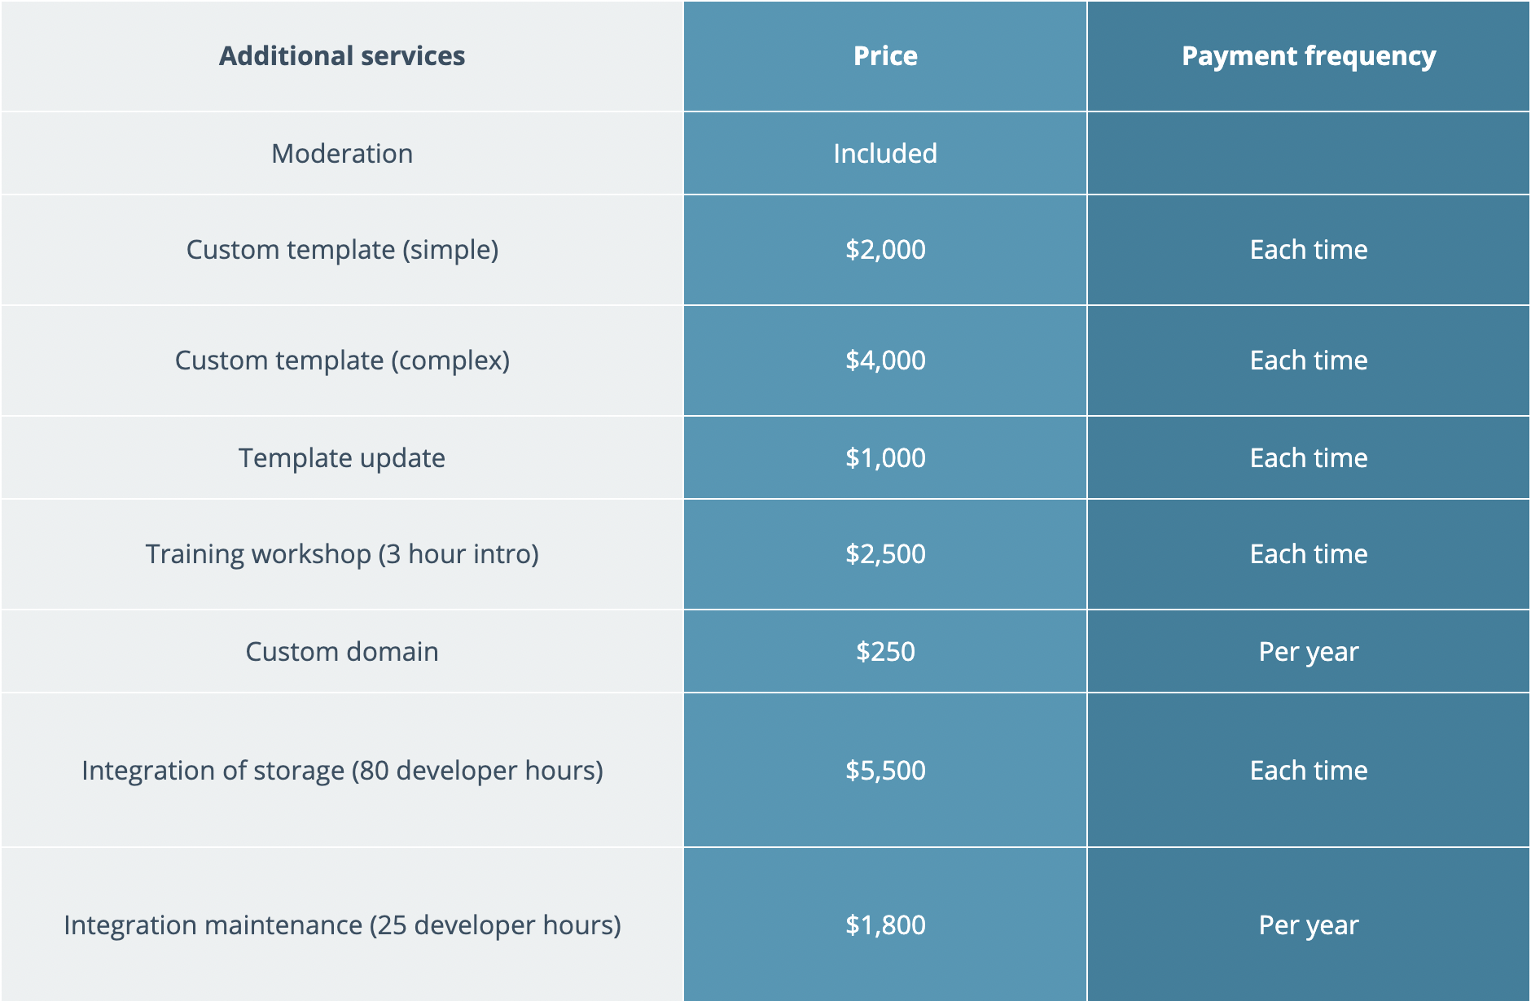
OSF REGISTRIES

Slide 25
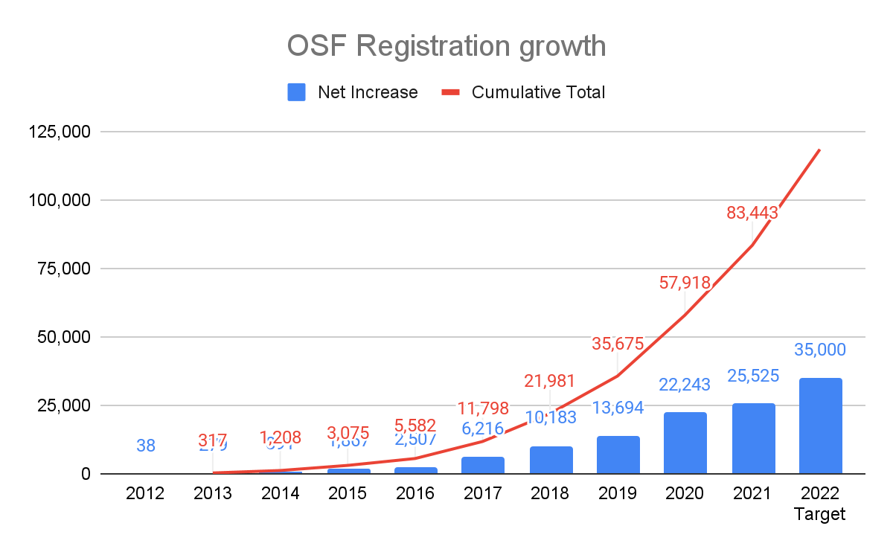
OSF Registrations Overview
10 different form templates currently offered
OSF Preregistration
Open-Ended Registration
Qualitative (new)
Secondary Data Preregistration (new)
Registered Report Protocol Registration
Preregistration Template from AsPredicted.org
OSF-Standard Pre-Data Collection Registration
Replication Recipe Post-Completion
Replication Recipe Pre-Registration
PreRegistration in Social Psychology
12 different form templates discoverable at osf.io/registries/discover

Slide 26
Registration Roadmap
Registration Updates
Outcome Reporting
Form Logic
File Metadata

Slide 27
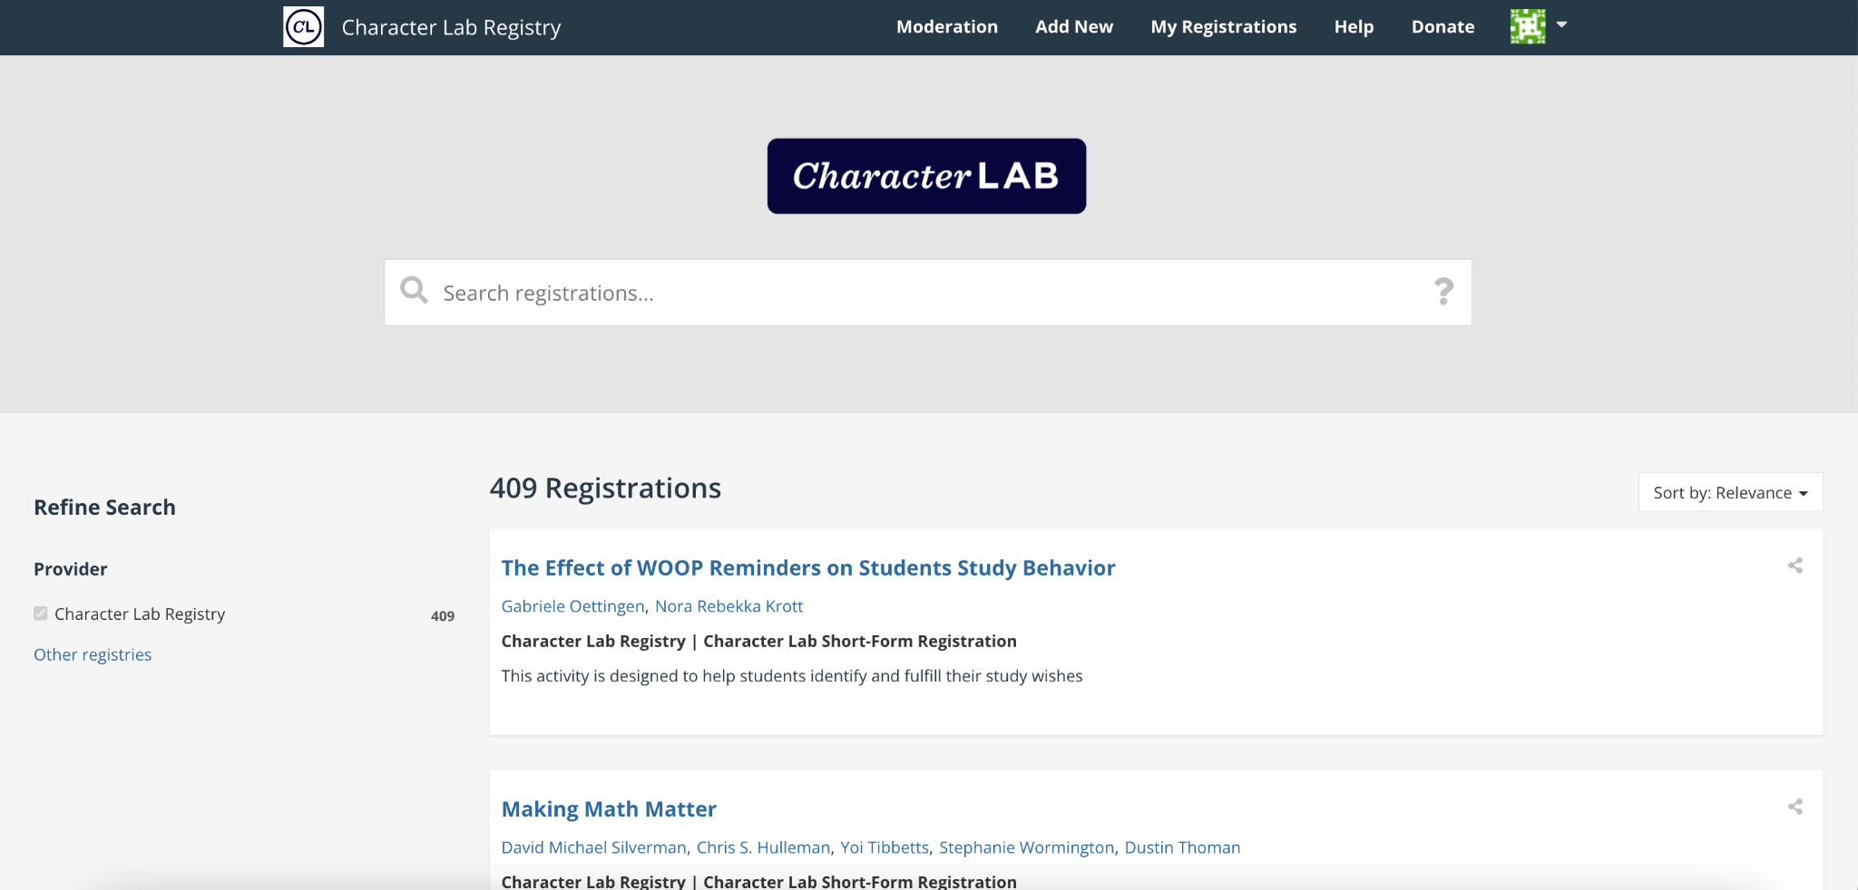
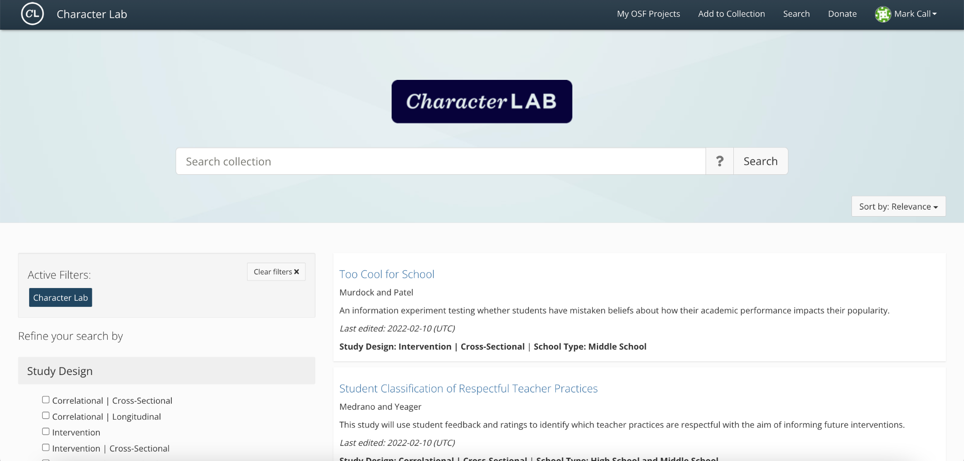

Slide 28
OSF Collections

Slide 29
OSF COLLECTIONS
A solution for funders, journals, societies, communities, organizations, and other groups in need of building and searching collections of related OSF projects.

Slide 30

Communities
Communities enabling open practices
Researchers are more likely to adopt reproducible practices when they are backed by community leadership and support. Learn about the groups, institutions, and funders partnering with COS to equip their researchers with open infrastructure, methods, and training.

Slide 31
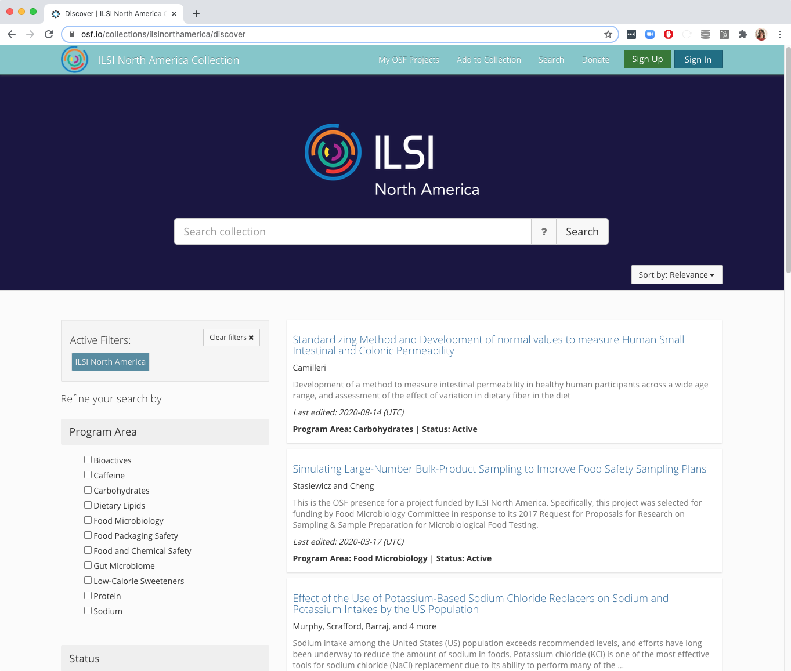
OPEN SCIENCE INFRASTRUCTURE, TOOLS, AND SERVICES
Infrastructure for culture change
Researchers and stakeholders around the world rely on trusted infrastructure and workflows to enable their efforts to conduct rigorous, transparent research.
COS provides open-source, public goods infrastructure and customizable solutions for groups to cultivate culture change in their own communities.
Read how groups like ILSI North America are using OSF Collections to improve the visibility of the scope and rigor of studies conducted by their funded investigators.

Slide 32
OSF COLLECTIONS
Empowering communities to improve research rigor.

Slide 33
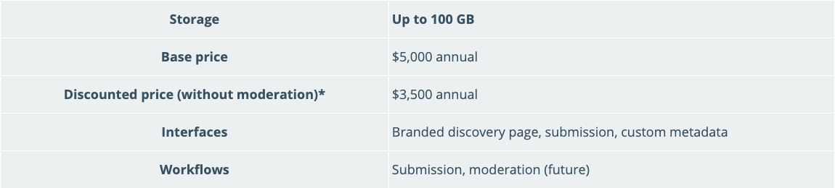
OSF COLLECTIONS
Shared infrastructure, is sustainable infrastructure
COS believes in shared investment in open source, community infrastructure
*Discount criteria: Discounts are active until collection moderation is made available. Base price will resume at the time of collection renewal, and for any new collections launched after that time.

Slide 34
COS Training/Workshops

Slide 35
COS Training Services
Increasing rigor often requires that researchers and labs implement new practices, learn new tools, or master unfamiliar statistical techniques. The good news is that COS offers a variety of training and consulting services to help you navigate this complexity.
We have produced modular reproducible research practices curriculum, which is public here (https://osf.io/6pjgy/)
In the past, COS had dedicated trainers to support this service.
A previous “one size fits all” approach often did not support particular stakeholder needs, so workshops are customized.
We are using these modules for training delivery currently, and will be doing more marketing around the service soon
Eventually, we would like to drive toward community delivery.

Slide 36
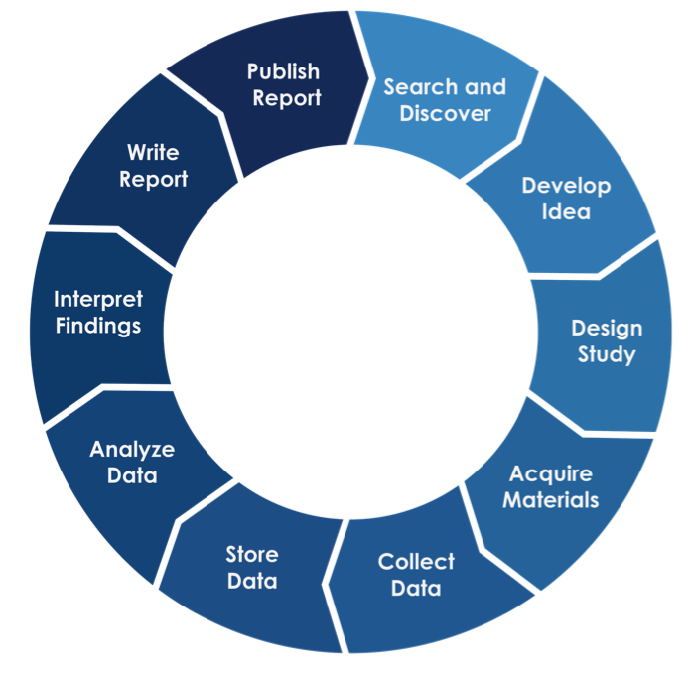
Reproducibility learning paths
Hands-on research sharing kickstarter
Hands-on data management kickstarter
Reproducible methods: how to find them & write them
How to organize painless research collaborations
Introduction to registrations & registered reports
Notes:
Data management is a great place to start on a learning path to better research.
This workshop does not have any prerequisites.
If you wish to build upon what you do today, there are other workshops that can introduce you to further open and reproducible research practices.

Slide 37
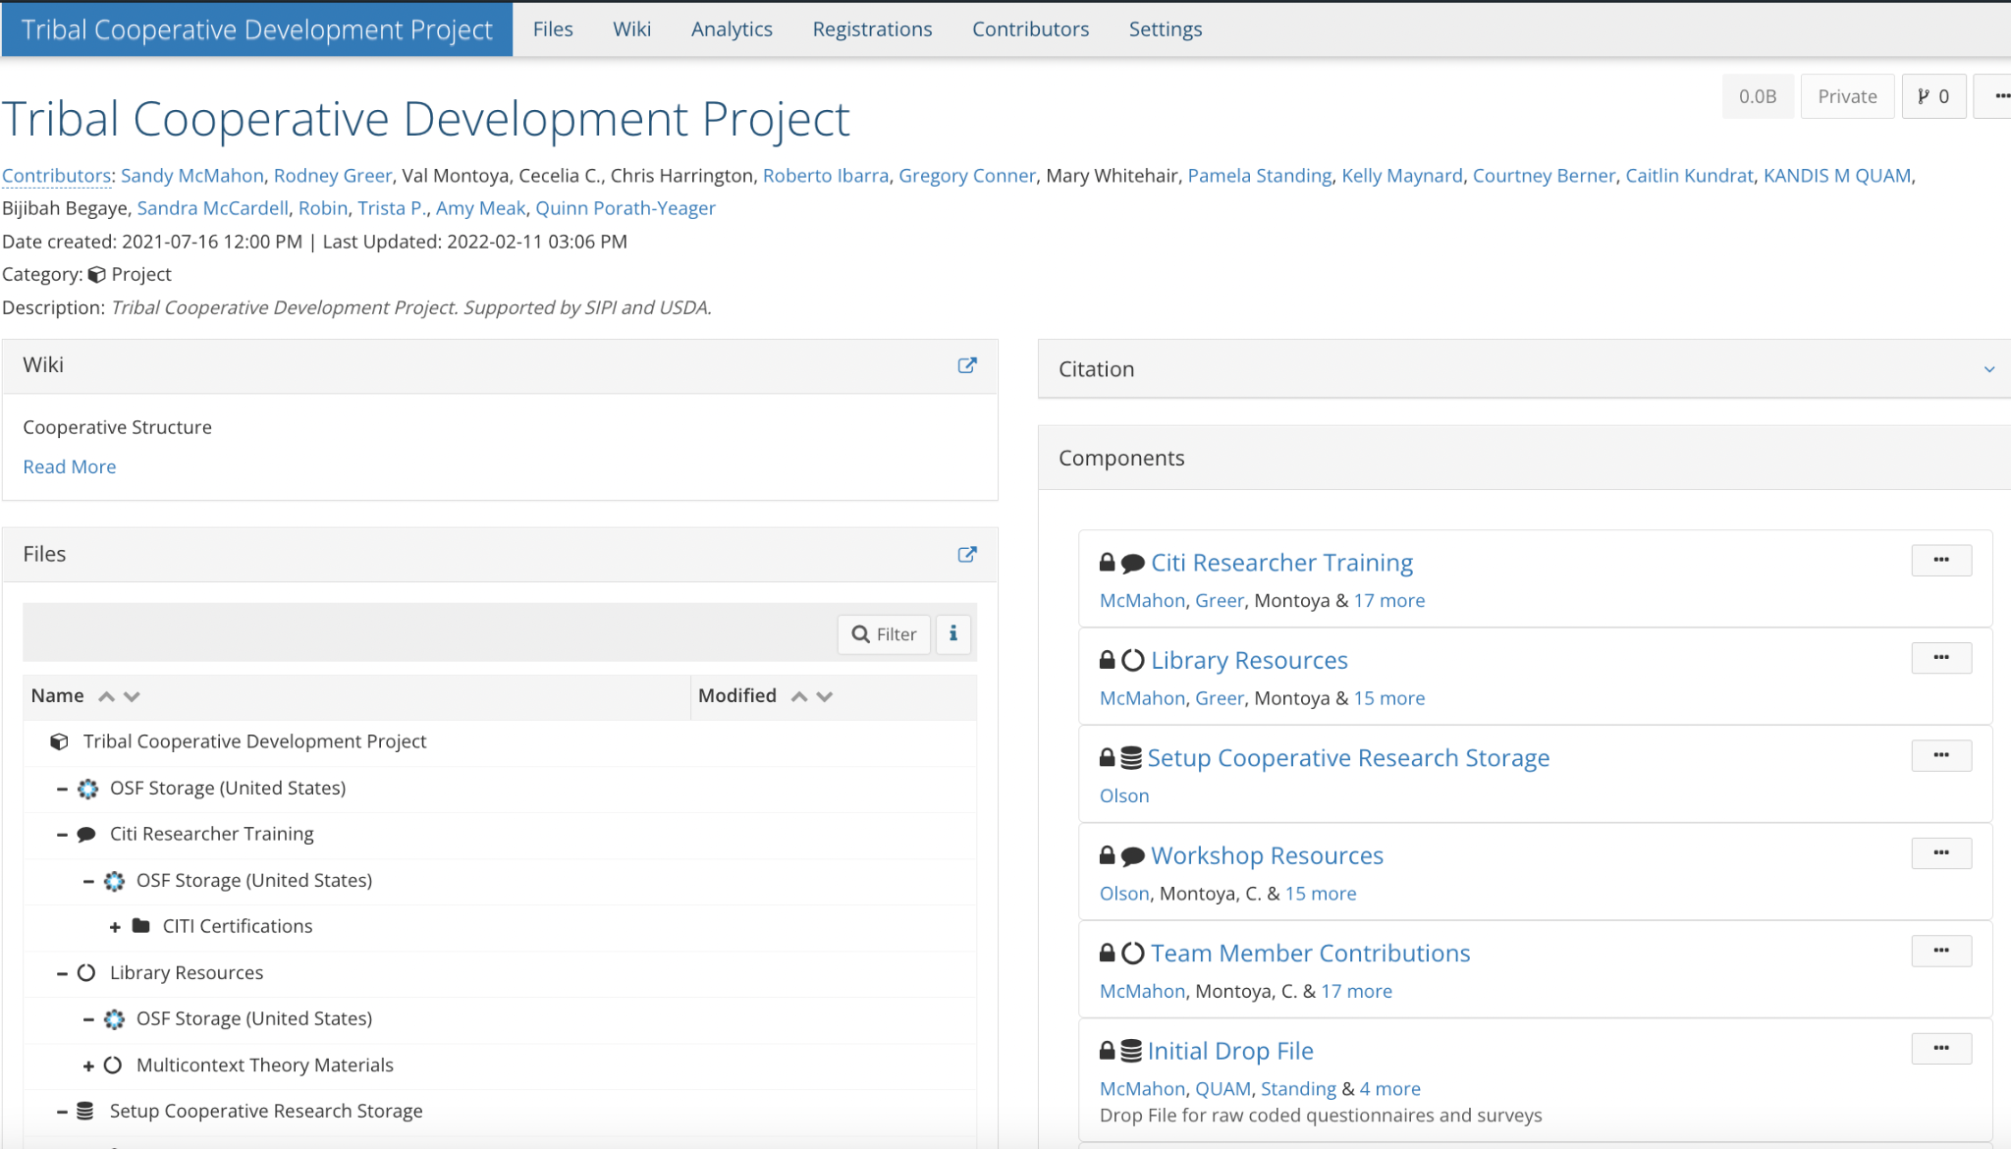
Partner$ that make it rain!

Slide 38
OSF Preprints

Slide 39
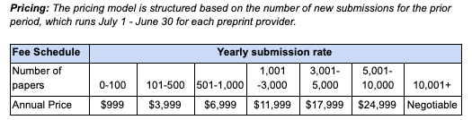
OSF Preprints
Vision
COS built and maintains OSF preprints infrastructure to facilitate new models of scholarly communication across research disciplines and geographic regions, thereby improving accessibility and speed of discovery. The infrastructure currently supports 25 communities operating their own preprint servers, determining their own editorial focus, licensing requirements, subject taxonomy, branding and logos, and moderation and withdrawal policies.
Launch
Fees start in 2020, with 62% subsidized by COS, now 70% subsidized
Of the 25 community-run preprint servers, 16 will pay or have paid their fees in 2020 resulting in $41,943 in fee-for-service revenue, three services requested an extension until end of 2020, two services are unsure at this time, and four moved off of the platform. 2021 preprint service fees have already been provided to the community preprint services, with COS supporting 73% of the total cost of $225,923 and the 22 current services paying fees totaling $61,975 to support the other 27% of the cost.

Slide 40
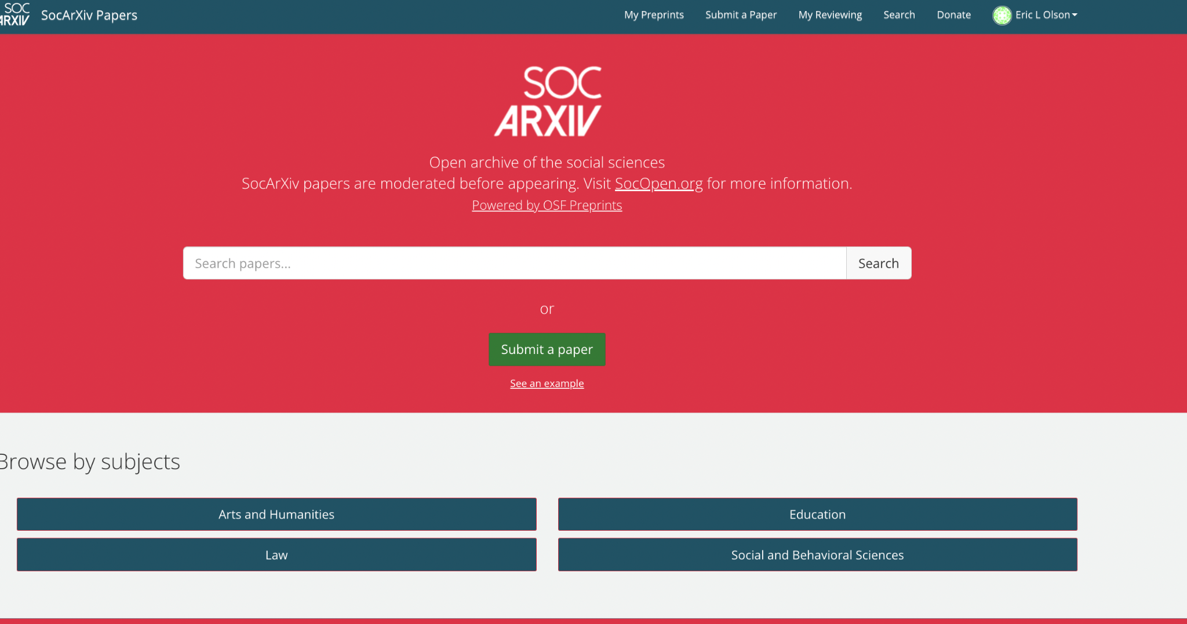
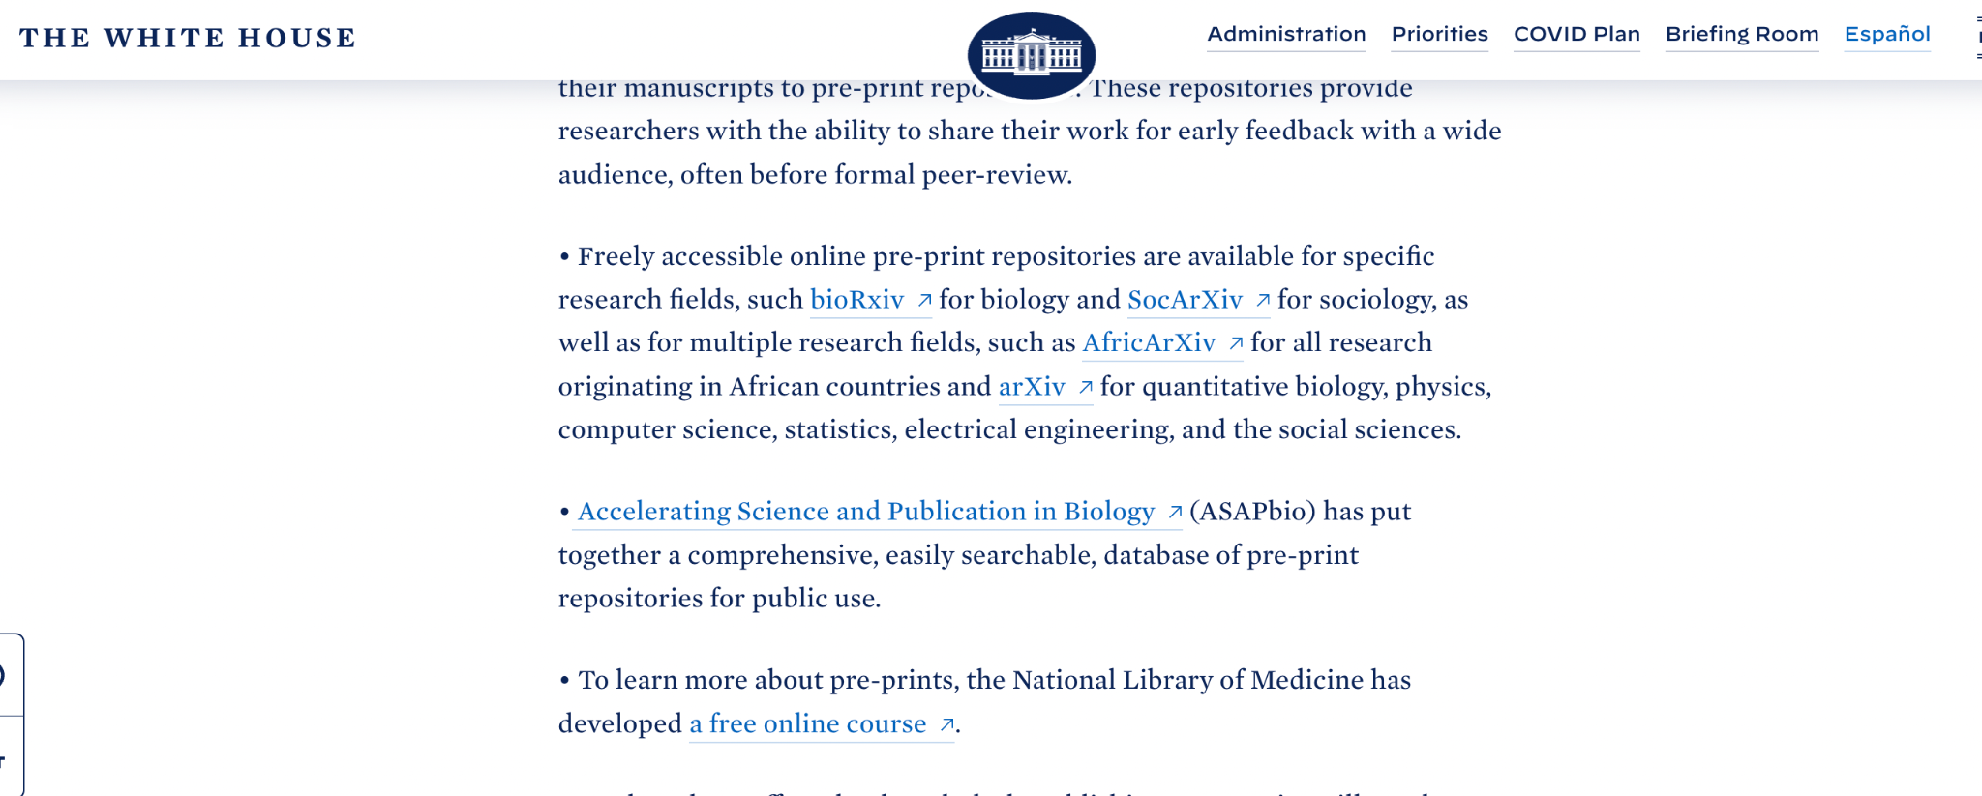
Partner$ that make it rain!

Slide 41
Interoperability with OSF

Slide 42



Integrators and Interoperability
OSF maintains a free and open API, an Application Programming Interface, that can be used to extend OSF capabilities into other custom software development projects.
APIs enable different systems to “talk” to one another, exchanging information that would be otherwise inaccessible.
https://www.cos.io/communities/software-developers

Slide 43
Integrators and Interoperability
We want to enable any tool to connect with OSF users and features. For example…
osfclient – Command-line client for uploading and downloading files to and from OSF
osfr – R interface to the OSF
PresQT – An open-source tool suite with RESTful services to improve preservation and re-use of research data and software
(New!) protocols.io – Move protocols and documents to and from OSF
And more!
https://www.cos.io/communities/software-developers

Slide 44
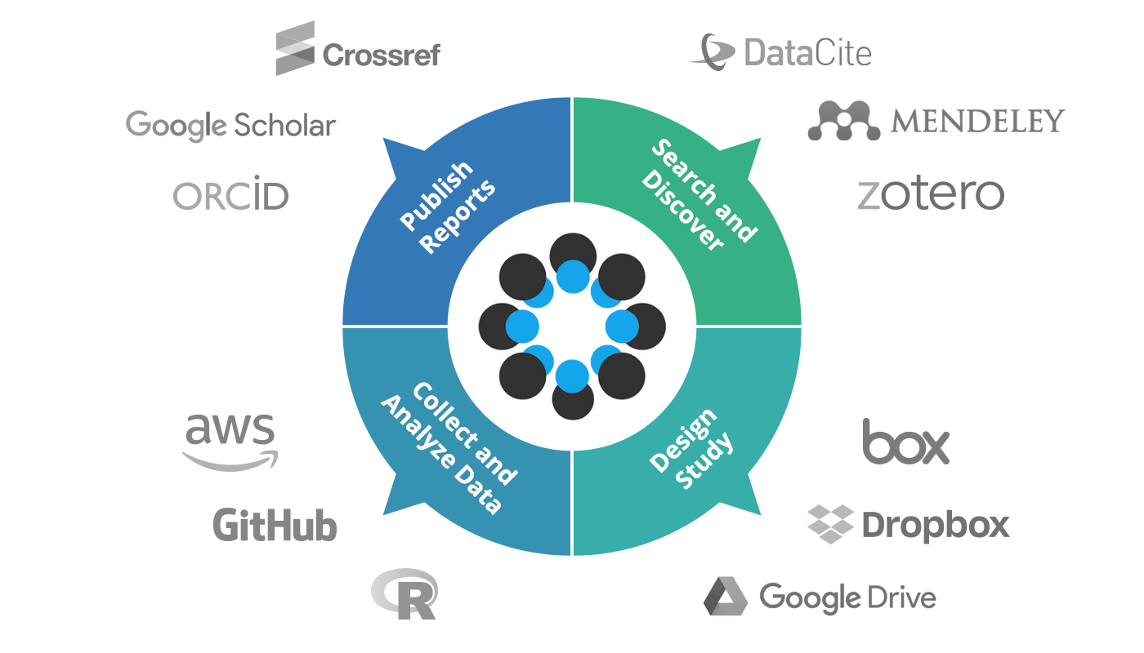
Integrators and Interoperability
We also want to meet researchers where they are by enabling integrations with other tools and services that they utilize at each stage of the research lifecycle. This allows a user can store their data or citations in the places that they already use and trust, but still connect them with their OSF projects and collaborators without any duplication of effort.
https://www.cos.io/products/osf

Slide 45
What now? Integration frenzy!
COS and the OSF partner with research communities in many ways, including the development of add-ons and other integrations. I want to chat with anyone who has an interest in integrating their tools, or have a potential integration with tools that their communities value and use!
Things that are coming soon:
An OSF Institutions member has supported the enhancement of OneDrive integration with write, copy, and move features, as well as connections to institutional OneDrive accounts.
Local and even regional/consortial repository integrations
Another OSF Institutions member developing and merging more storage and even computing resource add-ons
And more partnerships to come!
https://www.cos.io/products/osf-institutions

Slide 46
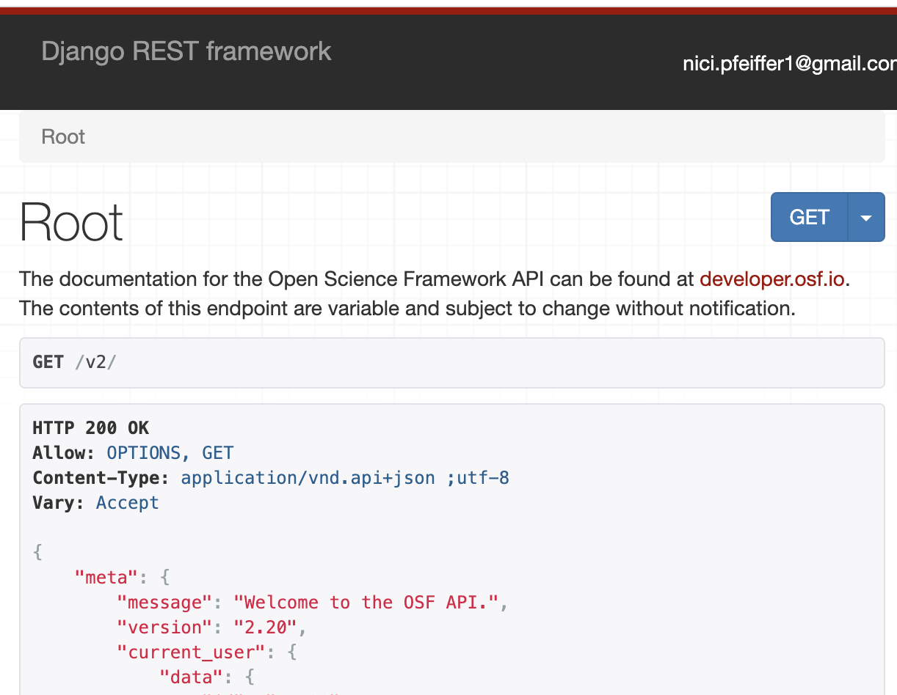
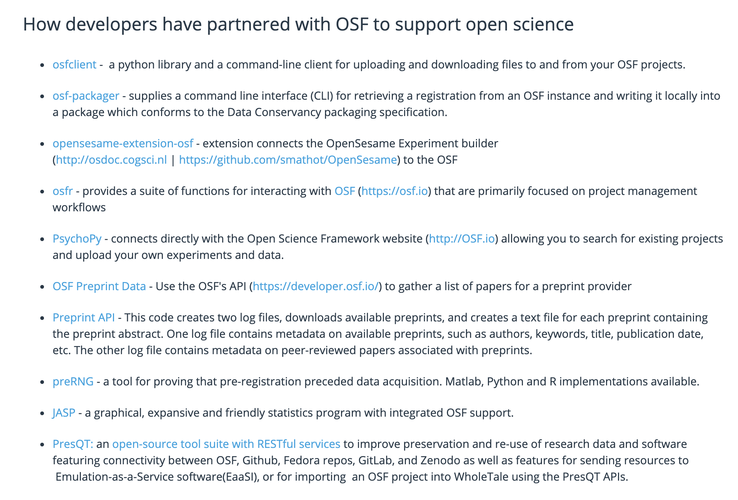
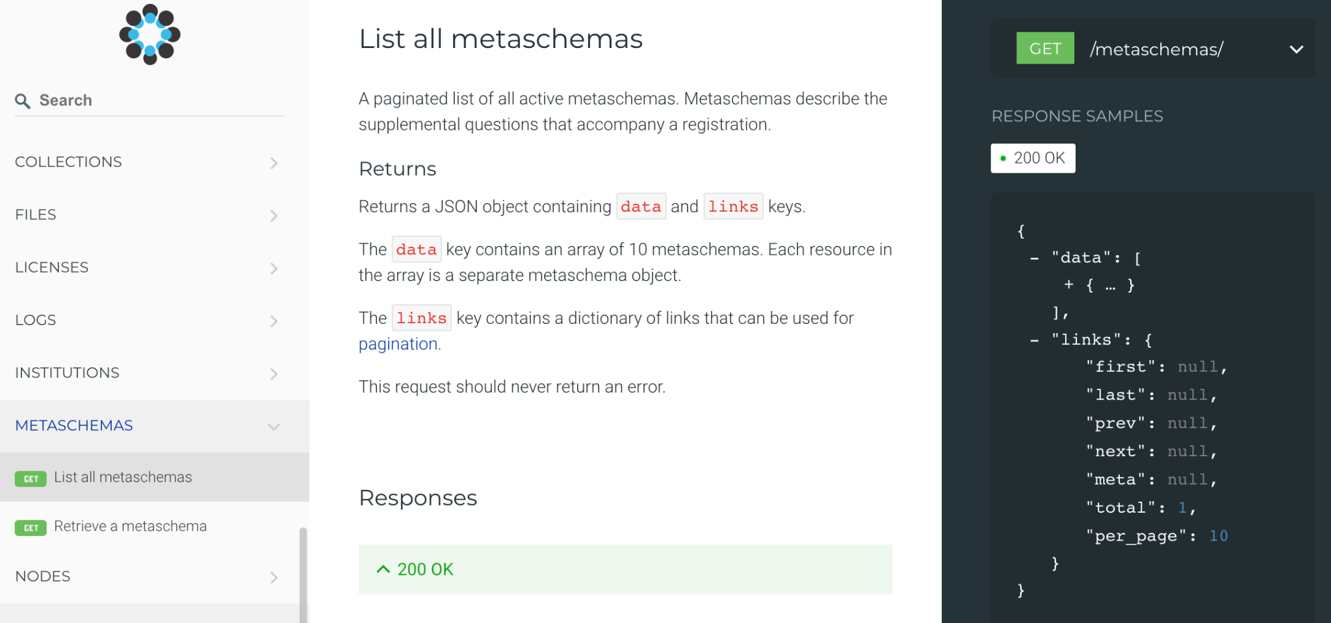
OSF API
Notes:
https://www.cos.io/communities/software-developers

Slide 47
OSF Meetings

Slide 48
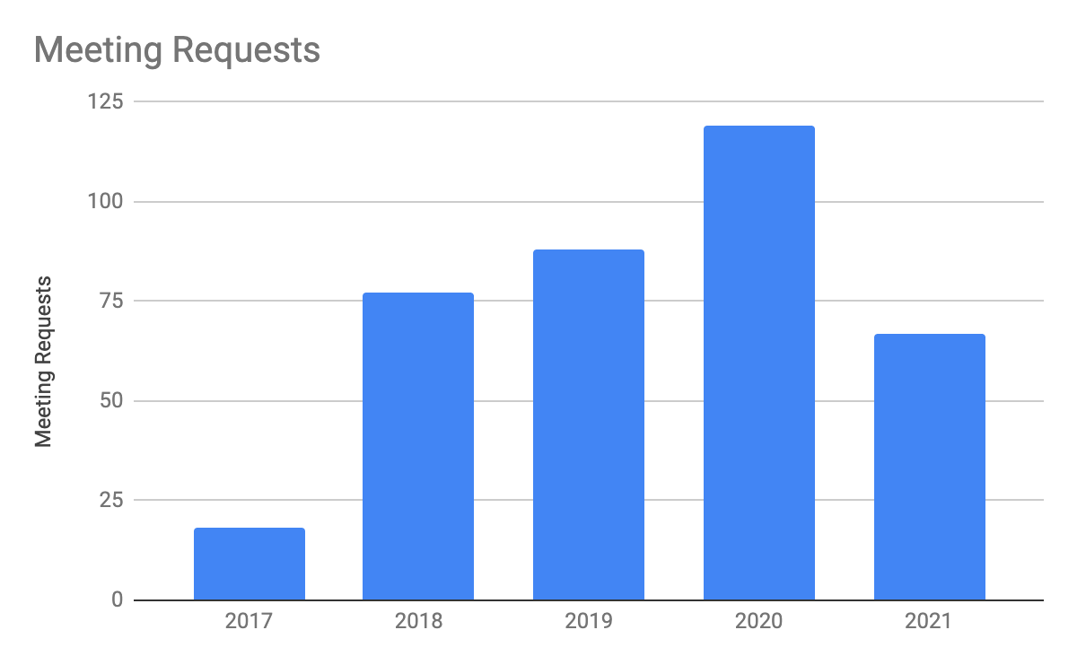
OSF Meetings
Vision
Conference organizers a branded landing page, simple submission process providing an easy way to share research content, and simple search and discovery. Researchers who share materials can add supplementary data, code, preprints, or other material alongside their poster or slides.
Notes:
https://osf.io/meetings
2022 support:
https://centerforopenscience.lightning.force.com/lightning/r/Campaign/7016g000000dpbFAAQ/view
2021 Support:
https://centerforopenscience.lightning.force.com/lightning/r/Campaign/7016g00000205BzAAI/view

Slide 49
Product+Services Overview

Slide 50
COS Services? Memberships?
What’s all this now?

Slide 51
OSF Adoption

Slide 52
2019-2021 Business Plan
Imperative #3: “Seek new sources of support beyond our historical reliance on research grants and generous philanthropic foundations. This includes launching fee for service experiments with different customer groups, including university and research funders.” (2019-2021 business plan)
Mission VS. Market
Change
Mission
Market
Notes:
Beyond our mission we have the 3 year business plan that guides our activities
From the current biz plan there was an imperative that was identified for focus on in the 3 years: diversify sources of support through launching fee for service.
We seek a culture change, we’ve established why we have built specific interfaces and infrastructure to enable the change.
- Typical process would start at the market analysis before deciding what to build.
- We did a culture analysis and decided what needed to be built to support the change in research culture
Mission vs. Market
- The mission pushes for increasing open behaviors; into what may not be comfortable
- The market pushes for status quo, incremental changes, or highly innovative changes that only a few adopt
- Asking the market only for what the product must do will not lead to the culture change we seek, or it will be weak
Pause, invite discussion
- connection to the mission
- create new markets, rather than just serve existing ones

Slide 53
COS products
Notes:
OSF is designed to support the entire Research lifecycle as a collaborative management tool.
4 phases of research
1. Planning – explore existing research (preprints), collaborate and structure (OSF), preregister study design (Registries)
2. Conducting – active research with open data management, data collection, analysis (OSF) (OSF integrations), aggregation of research(OSFI)
3. Reporting – sharing of open data, materials, code, metadata (OSF)(Meetings), open access publishing (Preprints)
4. Discovery – sharing work, improving discovery of all aspects, transparency and aggregate findings (Collections)(Meetings)
We have interfaces that support each of those phases as stand alone, but that also connect to the one before and after, bringing research full circle.

Slide 54
What’s involved in running a service at COS?
User support, support documentation, user communication
Client community or organization onboarding, support for operating branded interfaces, and adoption and goal support
Internal translation of user needs, backlog of new features, improvements, bugs, grooming, requirements, user stories, prioritized project list, product vision,
User research, testing, NPS, data for data-driven decision making
KPIs, metrics, product evaluation
External stakeholder and customer market analysis, communication, product positioning
Communications, Community engagement, needs/gap analysis, open practice adoption support (resources)
Marketing, campaigns, content development, resource prioritization and management
Developing and delivering training/workshop material, adoption resources, and engagement programming

Slide 55
Landscape alignment
Research Lifecycle
NASEM’s vision for repositories
Open Science By Design
NIH Generalist Repository

Slide 56
Partners in Open Science Infrastructure
How do we develop and maintain an ecosystem that can respond to many research community needs? Not alone!
We are constantly listening to and adapting for our 500,000 users and dozens of institutional partners. They in turn contributed 18 thousand preprints and 1 million projects that were downloaded over 23 million times in 2020 alone.
But key to the vision of OSF is to not create features that other services are already providing for researchers, so we seek integration at every opportunity!
Members and Supporters
Integrators and Interoperability
Research/Data Contributors and Consumers

Slide 57
Earned Revenue Model

Slide 58
Earned Revenue Model
The overarching principles guiding the earned revenue business models are:
Each product interface is designed for a specific initiation point for the supporting community to build adoption of new open behavior to create more normative behaviors. The ideal is for a community to add each of the interfaces to match their adoption of the open behaviors of preregistration (Registry), open sharing of data and materials (Collection), and open access reporting of findings (Preprint).
Value-based pricing will be used to set pricing for products and services based on the customer’s perceived value in meeting their goals, and is not heavily driven by the cost of the product or historical prices in the market. Volume-based pricing structures are in conflict with the success of the product adoption and the COS mission of culture change.
It’s simpler to set pricing tiers based on the levels of value that we can construct with the product or based on the customer’s ability to pay. We continue to implement value-based pricing that is aligned with our mission and goals, based on the key differentiators and market needs for each product.

Slide 59
FFS Launch and Growth
Preprints: Q1-2020
Institutions: Q2-2020
Collections: Q3-2020
Registries: Q4-2020
$276,796 total revenue across all FFS products and services in 2021
$430k in all-time FFS revenue
Building renewing revenue base, $250k+

Slide 60
OSF Institutions

Slide 61
Institutional Strategy
Vision
OSF Institutions provides an interface to institutions that connects researchers with collaborators and resources to amplify sharing, reuse, and discoverability.
Partnership through Membership
Partnering with research institutions to enable open science practices
Supporting administrators with activity insights
Partnerships form with the institution’s library staff and research admins
Promote adoption of open science practices and build researcher capacity to implement (OSF, training)
Offering a spectrum of options to match institutional investment and capability

Slide 62
Membership Tiers
Monthly newsletter
 | SSO
 | Affiliate projects
 | Public aggregated discovery
 |  | Custom URL
 |  | Dashboard
 |  | Support priority
 |  | Discounted training
 |  |  | Quarterly strategy calls
 |  |  | 1 Training incl | 2 Training incl
 |  |  |  | Integration (up to 80 hours)
 |  |  |  | Discounted dev contracting

Slide 63
OSFI Interfaces
Branded Aggregated Discovery
SSO Authentication
Dashboard Insights

Slide 64
OSFI Members
45
OSFI Members
You can go to osf.io/institutions to see the full list of members
Notes:
OSFI launched in late Q2 of 2020
In first year converted 16 to members

Slide 65
Partner$ that make it rain!

Slide 66
OSF Registries

Slide 67
OSF REGISTRIES
Improve Transparency and Rigor of Research
You set the standards. We’ve built the infrastructure.
Community operated registries are customized to meet the standards set by the stakeholders in your community. By launching a registry, you reflect the high expectations of transparency and rigor of your research area.

Slide 68
OSF REGISTRIES
A community-driven, open source service to improve research rigor and accelerate progress

Slide 69
OSF REGISTRIES
Benefits
Community operated registries are customized to meet the standards set by the stakeholders in your community. By launching a registry, you reflect the high expectations of transparency and rigor of your research area.

Slide 70
OSF REGISTRIES
Empowering communities to improve research rigor.

Slide 71
OSF REGISTRIES
Shared infrastructure, is sustainable infrastructure
COS believes in shared investment in open source, community infrastructure
*Discount criteria: Discounted prices are applied until registry moderation, logic forms functionality, and outcome reporting are made available. Base price will resume at the time of registry renewal, and for any new registries launched after that time. (Expected in 2023)

Slide 72
OSF REGISTRIES

Slide 73
OSF Registrations Overview
10 different form templates currently offered
OSF Preregistration
Open-Ended Registration
Qualitative (new)
Secondary Data Preregistration (new)
Registered Report Protocol Registration
Preregistration Template from AsPredicted.org
OSF-Standard Pre-Data Collection Registration
Replication Recipe Post-Completion
Replication Recipe Pre-Registration
PreRegistration in Social Psychology
12 different form templates discoverable at osf.io/registries/discover

Slide 74
Registration Roadmap
Registration Updates
Outcome Reporting
Form Logic
File Metadata

Slide 76
OSF Collections

Slide 77
OSF COLLECTIONS
A solution for funders, journals, societies, communities, organizations, and other groups in need of building and searching collections of related OSF projects.

Slide 78
Communities
Communities enabling open practices
Researchers are more likely to adopt reproducible practices when they are backed by community leadership and support. Learn about the groups, institutions, and funders partnering with COS to equip their researchers with open infrastructure, methods, and training.

Slide 79
OPEN SCIENCE INFRASTRUCTURE, TOOLS, AND SERVICES
Infrastructure for culture change
Researchers and stakeholders around the world rely on trusted infrastructure and workflows to enable their efforts to conduct rigorous, transparent research.
COS provides open-source, public goods infrastructure and customizable solutions for groups to cultivate culture change in their own communities.
Read how groups like ILSI North America are using OSF Collections to improve the visibility of the scope and rigor of studies conducted by their funded investigators.

Slide 80
OSF COLLECTIONS
Empowering communities to improve research rigor.

Slide 81
OSF COLLECTIONS
Shared infrastructure, is sustainable infrastructure
COS believes in shared investment in open source, community infrastructure
*Discount criteria: Discounts are active until collection moderation is made available. Base price will resume at the time of collection renewal, and for any new collections launched after that time.

Slide 82
COS Training/Workshops

Slide 83
COS Training Services
Increasing rigor often requires that researchers and labs implement new practices, learn new tools, or master unfamiliar statistical techniques. The good news is that COS offers a variety of training and consulting services to help you navigate this complexity.
We have produced modular reproducible research practices curriculum, which is public here (https://osf.io/6pjgy/)
In the past, COS had dedicated trainers to support this service.
A previous “one size fits all” approach often did not support particular stakeholder needs, so workshops are customized.
We are using these modules for training delivery currently, and will be doing more marketing around the service soon
Eventually, we would like to drive toward community delivery.

Slide 84
Reproducibility learning paths
Hands-on research sharing kickstarter
Hands-on data management kickstarter
Reproducible methods: how to find them & write them
How to organize painless research collaborations
Introduction to registrations & registered reports
Notes:
Data management is a great place to start on a learning path to better research.
This workshop does not have any prerequisites.
If you wish to build upon what you do today, there are other workshops that can introduce you to further open and reproducible research practices.

Slide 85
Partner$ that make it rain!

Slide 86
OSF Preprints

Slide 87
OSF Preprints
Vision
COS built and maintains OSF preprints infrastructure to facilitate new models of scholarly communication across research disciplines and geographic regions, thereby improving accessibility and speed of discovery. The infrastructure currently supports 25 communities operating their own preprint servers, determining their own editorial focus, licensing requirements, subject taxonomy, branding and logos, and moderation and withdrawal policies.
Launch
Fees start in 2020, with 62% subsidized by COS, now 70% subsidized
Of the 25 community-run preprint servers, 16 will pay or have paid their fees in 2020 resulting in $41,943 in fee-for-service revenue, three services requested an extension until end of 2020, two services are unsure at this time, and four moved off of the platform. 2021 preprint service fees have already been provided to the community preprint services, with COS supporting 73% of the total cost of $225,923 and the 22 current services paying fees totaling $61,975 to support the other 27% of the cost.

Slide 88
Partner$ that make it rain!

Slide 89
Interoperability with OSF

Slide 90
Integrators and Interoperability
OSF maintains a free and open API, an Application Programming Interface, that can be used to extend OSF capabilities into other custom software development projects.
APIs enable different systems to “talk” to one another, exchanging information that would be otherwise inaccessible.
https://www.cos.io/communities/software-developers

Slide 91
Integrators and Interoperability
We want to enable any tool to connect with OSF users and features. For example…
osfclient – Command-line client for uploading and downloading files to and from OSF
osfr – R interface to the OSF
PresQT – An open-source tool suite with RESTful services to improve preservation and re-use of research data and software
(New!) protocols.io – Move protocols and documents to and from OSF
And more!
https://www.cos.io/communities/software-developers

Slide 92
Integrators and Interoperability
We also want to meet researchers where they are by enabling integrations with other tools and services that they utilize at each stage of the research lifecycle. This allows a user can store their data or citations in the places that they already use and trust, but still connect them with their OSF projects and collaborators without any duplication of effort.
https://www.cos.io/products/osf

Slide 93
What now? Integration frenzy!
COS and the OSF partner with research communities in many ways, including the development of add-ons and other integrations. I want to chat with anyone who has an interest in integrating their tools, or have a potential integration with tools that their communities value and use!
Things that are coming soon:
An OSF Institutions member has supported the enhancement of OneDrive integration with write, copy, and move features, as well as connections to institutional OneDrive accounts.
Local and even regional/consortial repository integrations
Another OSF Institutions member developing and merging more storage and even computing resource add-ons
And more partnerships to come!
https://www.cos.io/products/osf-institutions

Slide 94
OSF API
Notes:
https://www.cos.io/communities/software-developers

Slide 95
OSF Meetings

Slide 96
OSF Meetings
Vision
Conference organizers a branded landing page, simple submission process providing an easy way to share research content, and simple search and discovery. Researchers who share materials can add supplementary data, code, preprints, or other material alongside their poster or slides.
Notes:
https://osf.io/meetings
2022 support:
https://centerforopenscience.lightning.force.com/lightning/r/Campaign/7016g000000dpbFAAQ/view
2021 Support:
https://centerforopenscience.lightning.force.com/lightning/r/Campaign/7016g00000205BzAAI/view

